Slide 1
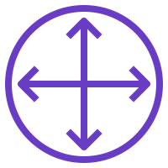





Arquitetura na AWS:
AWS Cloud
VPC – 10.1.0.0/16
Public subnet 10.1.1.0/24
Public subnet 10.1.2.0/24
Security group
Security group
FRONTEND
JENKINS
BACKEND

